Slide 1
Computer Organization and Architecture
GPU Computing
Ferosh Jacob
Kennesaw State University

Slide 2
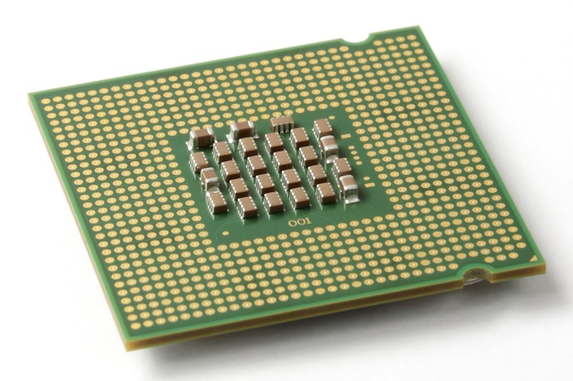
The CPU
The “Central Processing Unit”
Traditionally, applications use CPU for primary calculations
General-purpose capabilities
Established technology
Usually equipped with 8 or less powerful cores
Optimal for concurrent processes but not large scale parallel computations
Wikimedia commons: Intel_CPU_Pentium_4_640_Prescott_bottom.jpg

Slide 3
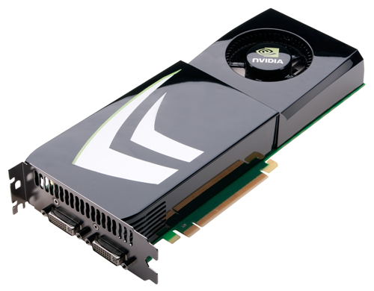
The GPU
The "Graphics Processing Unit"
Relatively new technology designed for parallelizable problems
Initially created specifically for graphics
Became more capable of general computations

Slide 4
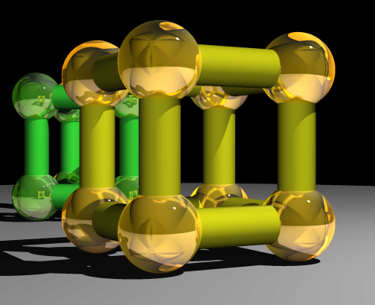
GPUs – The Motivation
Raytracing:
for all pixels (i,j):
Calculate ray point and direction in 3d space
if ray intersects object:
calculate lighting at closest object
store color of (i,j)
Superquadric Cylinders, exponent 0.1, yellow glass balls, Barr, 1981

Slide 5
EXAMPLE
Add two arrays
A[ ] + B[ ] -> C[ ]
On the CPU:
float *C = malloc(N * sizeof(float));
for (int i = 0; i < N; i++)
C[i] = A[i] + B[i];
return C;
This operates sequentially… can we do better?

Slide 6
A simple problem…
On the CPU (multi-threaded, pseudocode):
(allocate memory for C)
Create # of threads equal to number of cores on processor (around 2, 4, perhaps 8)
(Indicate portions of A, B, C to each thread...)
...
In each thread,
For (i from beginning region of thread)
C[i] <- A[i] + B[i]
//lots of waiting involved for memory reads, writes, ...
Wait for threads to synchronize...
This is slightly faster – 2-8x (slightly more with other tricks)

Slide 7
A simple problem…
How many threads? How does performance scale?
Context switching:
High penalty on the CPU
Not an issue on the GPU

Slide 8
A simple problem…
On the GPU:
(allocate memory for A, B, C on GPU)
Create the “kernel” – each thread will perform one (or a few) additions
Specify the following kernel operation:
For all i‘s (indices) assigned to this thread:
C[i] <- A[i] + B[i]
Start ~20000 (!) threads
Wait for threads to synchronize...

Slide 9
GPU: Strengths Revealed
Emphasis on parallelism means we have lots of cores
This allows us to run many threads simultaneously with no context switches

Slide 10
GPU Computing: Step by Step
Setup inputs on the host (CPU-accessible memory)
Allocate memory for outputs on the host
Allocate memory for inputs on the GPU
Allocate memory for outputs on the GPU
Copy inputs from host to GPU
Start GPU kernel
Copy output from GPU to host
NOTE: Copying can be asynchronous

Slide 11
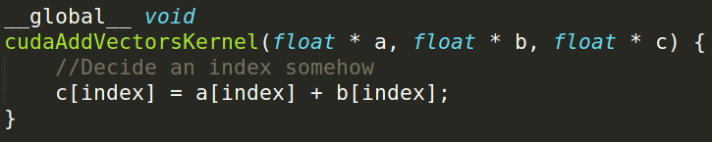
The Kernel
Our “parallel” function
Given to each thread
Simple implementation:

Slide 12
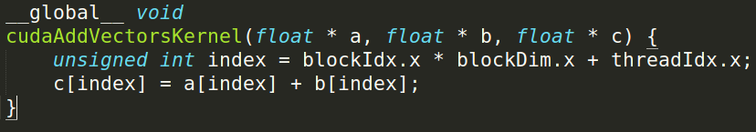
Indexing
Can get a block ID and thread ID within the block:
Unique thread ID!

Slide 13
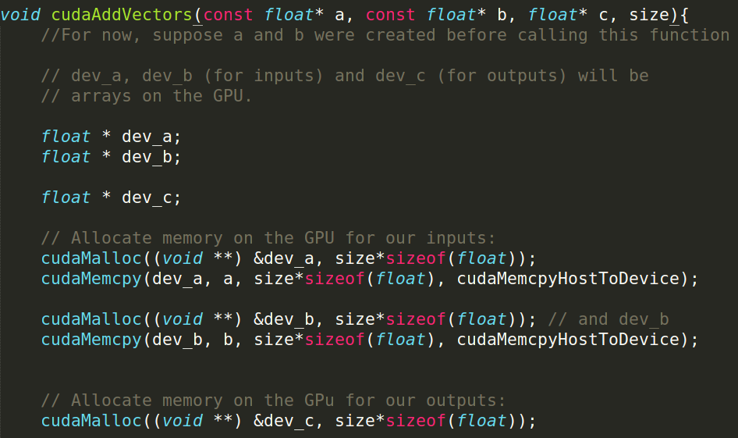
Calling the Kernel

Slide 14
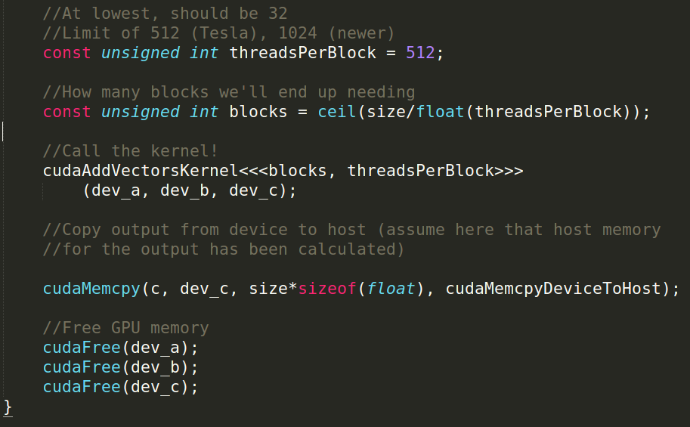
Calling the Kernel (2)

Slide 15
GPUs – Brief History
“General-purpose computing on GPUs” (GPGPU)
Hardware has gotten good enough to a point where it’s basically having a mini-supercomputer
CUDA (Compute Unified Device Architecture)
General-purpose parallel computing platform for NVIDIA GPUs
OpenCL (Open Computing Language)
General heterogenous computing framework
Both are accessible as extensions to various languages
If you’re into python, checkout theano

Slide 16
GPU Memory
Registers
Local memory
Global memory
Shared memory
Notes:
Give brief explanation of each type of memory.
I’ll go over the most important types of memory first.

Slide 17
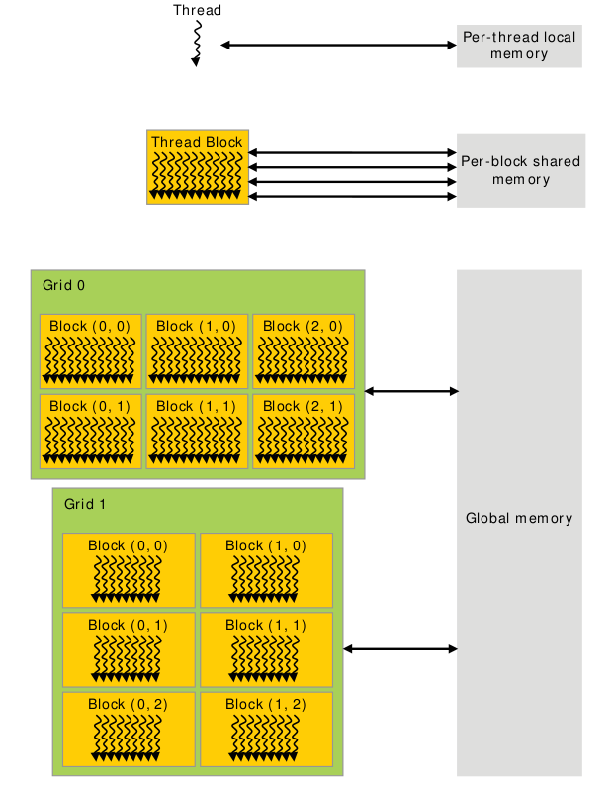
Memory Scope
Notes:
When talking about different memory types, we need to talk about both the scope as well as the hardware implementation.
The scope is simply who can access the memory and what is the lifetime of the memory.
Notably, the hardware implementation can limit the scope (as is the case for local memory), but the scope is often limited beyond what the hardware does.

Slide 18
Global Memory
Global memory is separate hardware from the GPU core (containing SM’s, caches, etc).
The vast majority of memory on a GPU is global memory
If data doesn’t fit into global memory, you are going to have process it in chunks that do fit in global memory.
GPUs have .5 - 24GB of global memory, with most now having ~2GB.
Global memory latency is ~300ns on Kepler and ~600ns on Fermi

Slide 19
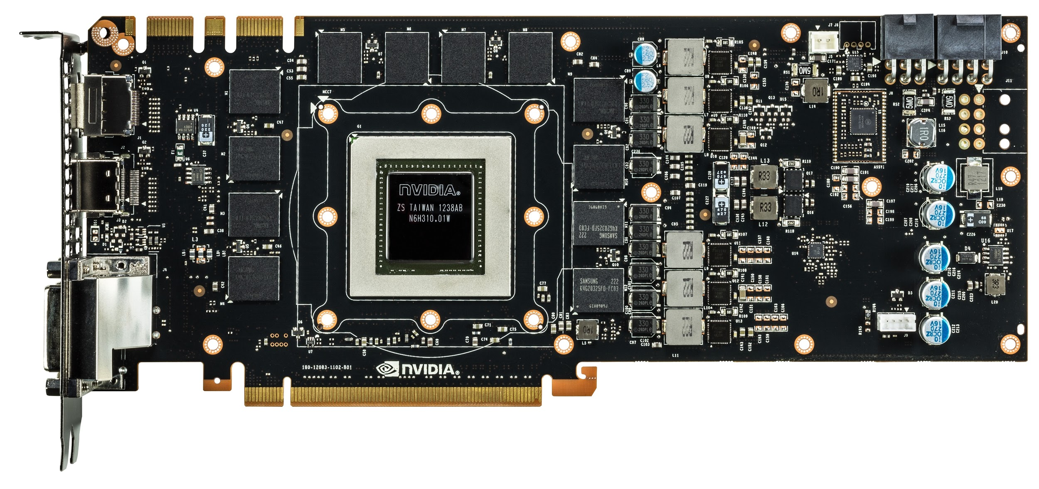
Green box is GK110, red lines are global memory
Nvidia GeForce GTX 780
Notes:
Everything we’ve been talking about is the GPU core. These are made by Nvidia and are the “interesting” part of the GPU.
The global memory is not part of the GPU core, and is in this case manufactured by Samsung. Its RAM similar to what is already in your computer.
Note that not being located on the same silicon generally hurts performance. This is true for accessing global memory from the GPU, and is also (very) true for moving data to GPU over PCI-E.
Light travels about 1 foot each ns (in vacuum).

Slide 20
Accessing global memory efficiently
Global memory IO is the slowest form of IO on GPU
except for accessing host memory (duh...)
Because of this, we want to access global memory as little as possible
Access patterns that play nicely with GPU hardware are called coalesced memory accesses.

Slide 21
Memory Coalescing
Memory accesses are done in large groups setup as Memory Transactions
Done per warp
Fully utilizes the way IO is setup at the hardware level
Coalesced memory accesses minimize the number of cache lines read in through these memory transactions
GPU cache lines are 128 bytes and are aligned
Memory coalescing is much more complicated in reality
See Ch 5.2 of CUDA Handbook for more detail if you're interested but it's not required
Notes:
Explain what a cache line is from perspective of CPU.
On CPU, 1 load only touches 1 cache line. On GPU, not the case.
Follow with several slides of pictures.

Slide 22
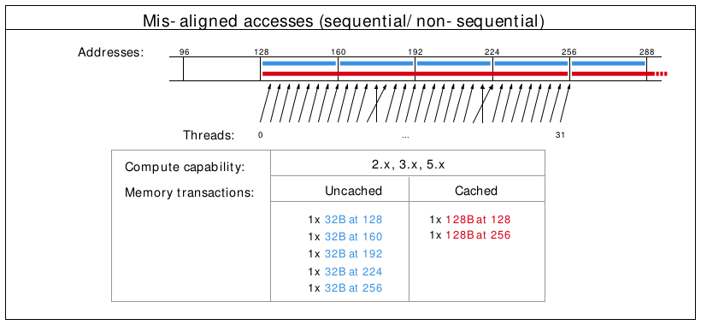
Misalignment can cause non-coalesced access
Notes:
The cross lines don’t matter, but the misalignment causes 2 loads to be done (because first loaded address is 130 rather than 120)

Slide 23
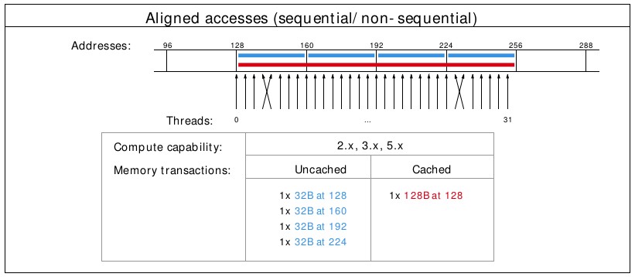
A coalesced access!
Notes:
The cross lines don’t matter, just the total number of cache lines touched.

Slide 24
Shared Memory
Very fast memory located in the SM
Same hardware as L1 cache (will discuss later)
~5ns of latency
Maximum size of 48KB, but user configurable
Scope of shared memory is the block
Remember
SM = streaming multiprocessor
SM ≠ shared memory
Notes:
Nvidia says shared memory latency is “roughly 100x lower”, so probably closer to 3ns, but 5ns is closer enough and easier to think about.
Why is scope of shared memory not global?

Slide 25
Shared memory syntax
Can allocate shared memory statically (size known at compile time) or dynamically (size not known until runtime)
Static allocation syntax:
__shared__ float data[1024];
Declared in the kernel, nothing in host code
Dynamic allocation syntax
Host:
kernel<<<grid_dim, block_dim, numBytesShMem>>>(args);
Device (in kernel):
extern __shared__ float s[];
For multiple dynamically sized variables, see this blog post
Little bit more complicated and there are easy alternatives

Slide 26
A shared memory application
Task: Compute byte frequency counts
Input: array of bytes of length n
Output: 256 element array of integers containing number of
occurrences of each byte
Naive: build output in global memory, n global stores
Smart: build output in shared memory, copy to global memory at end, 256 global stores
Notes:
You could declare byte frequency counts as a “stack” variable (local) and hope L1 cache does a good job.
For algorithms where you iteratively build output, you often want to do this in shared memory.

Slide 27
Computational Intensity
Computational intensity is a representation of how many operations must be done on a single data point (FLOPs / IO)
Vaguely similar to the big O notation in concept and usage
e.g)
Matrix multiplication: n³ / n² = n
n-body simulation: n² / n = n
If computational intensity is > 1, then same data used in more than 1 computation
Do as few global loads and as many shared loads as possible
Notes:
FLOP = floating point operations
IO = IO operations
blocking algorithms for matrix multiplication

Slide 28
A common pattern in kernels
copy from global memory to shared memory
__syncthreads()
perform computation, incrementally storing output in shared memory, __syncthreads() as necessary
copy output from shared memory to output array in global memory
Notes:
syncthreads works at block scope, synchronizes all warps in the block.
question: is __syncthreads needed to synchronize within a warp?
answer: not always, called warp synchronous coding. more about synchronization on friday

Slide 29
Bank Conflicts
Shared memory is setup as 32 banks
If you divide the shared memory into 4 byte-long elements, element i lies in bank i % 32.
A bank conflict occurs when 2 threads in a warp access different elements in the same bank.
Bank conflicts cause serial memory accesses rather than parallel
Serial anything in GPU programming = bad for performance

Slide 30
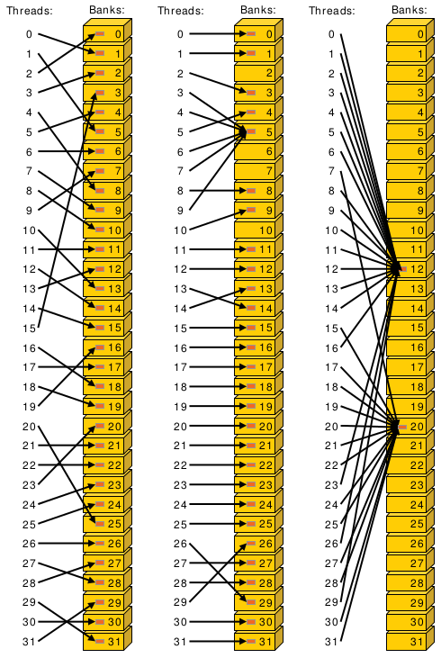
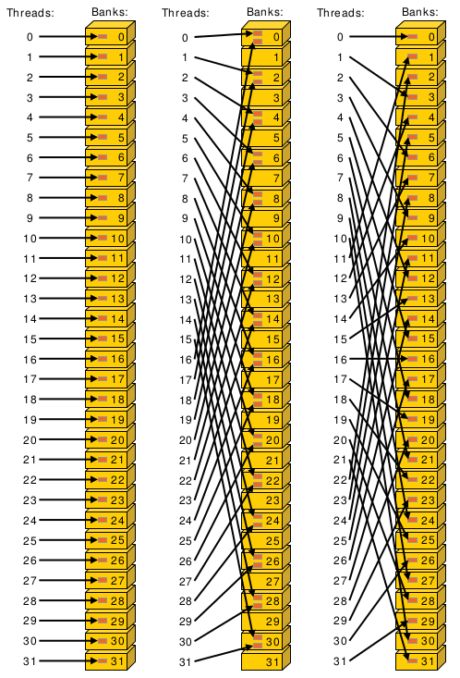
Bank conflict examples
Notes:
Center example would take roughly twice as long.
Bank conflicts might not seem like a huge deal (because access with 2-way bank conflict is same latency as arithmetic instruction) but can have significant effect on already partially tuned programs.

Slide 31
Bank conflicts and strides
Stride 1 ⇒ 32 x 1-way “bank conflicts” (so conflict-free)
Stride 2 ⇒ 16 x 2-way bank conflicts
Stride 3 ⇒ 32 x 1-way “bank conflicts” (so conflict-free)
Stride 4 ⇒ 8 x 4-way bank conflicts
…
Stride 32 ⇒ 1 x 32-way bank conflict :(
Notes:
Stride is distance from thread i access to thread i+1 access.
How many unique banks are accessed, and how many threads are accessing that bank

Slide 32
Padding to avoid bank conflicts
To fix the stride 32 case, we’ll waste a byte on padding and make the stride 33 :)
Don’t store any data in slots 32, 65, 98, ....
Now we have
thread 0 ⇒ index 0 (bank 0)
thread 1 ⇒ index 33 (bank 1)
thread i ⇒ index 33 * i (bank i)
Notes:
Note padding is wasting some very precious hardware, and also makes code uglier.

Slide 33
Registers
A Register is a piece of memory used directly by the processor
Fastest “memory” possible, about 10x faster than shared memory
There are tens of thousands of registers in each SM
Generally works out to a maximum of 32 or 64 32-bit registers per thread
Most stack variables declared in kernels are stored in registers
example: float x; (duh...)
Statically indexed arrays stored on the stack are sometimes put in registers
Notes:
Need to check assembly to see what is in registers.
Arrays must be statically indexed because instructions hard code register number.

Slide 34
Local Memory
Local memory is everything on the stack that can’t fit in registers
The scope of local memory is just the thread.
Local memory is stored in global memory
much slower than registers
Notes:
What’s the downside of storing local memory in global memory?
So how can we avoid storing anything in local memory?
Answer: use less local variables than registers
yes, but we’ve seen that using more local variables can help performance (assuming the local variables in registers)
sounds like we want to have as many variables that we can put in registers and no more!
If we have more local variables then registers, then some local variables will be spilled to local/global memory. This is called register spilling and kills performance.

Slide 35
Register spilling example
x0 = x[0];
y0 = y[0];
x1 = x[1];
y1 = y[1];
z0 = x0 + y0;
z1 = x1 + y1;
When we have enough registers, this code does 4 loads from local memory and 0 stores.
Now assume we only have 3 free registers before any of this code is executed (but don’t worry about z0 and z1)

Slide 36
Register spilling example
x0 = x[0];
y0 = y[0];
x1 = x[1];
y1 = y[1];
z0 = x0 + y0;
z1 = x1 + y1;
starting with only 3 free registers...
Register spilling cost:
1 extra load
1 extra store
2 extra pairs of consecutive
dependent instructions
cannot load y[1] until we free a register. store x1 to make space.
Now we need to load x1 again.
Notes:
Stores also have instruction dependencies (cannot use a register until the store from it is done).
The pairs of dependent instructions are the store x1, load y[1] (because we’re loading y1 into the same register that we’re storing from) and load x1, z1 = x1 + y1
There are worse spilling scenarios (what if x0 was stored?) and also better (just don’t load y1 until after computing z0), but its difficult for compiler to find optimal instruction ordering wrt spilling and dependencies.
A form of register allocation problem can be reduced to k-coloring a graph, which is NP-complete.
So, is register spilling (and any use of local memory) truly so bad for performance? Thankfully not (in small doses), due to the L1 cache.

Slide 37
Thanks
Slides adapted from
http://courses.cms.caltech.edu/cs179/

